Slide 1
ANXIETY & Depression Towards understanding & Supporting each other
Presentation by Mark Lowry
Community Educator
Alex Gow Funerals
(07) 3851 7800

Slide 2
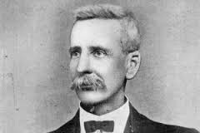
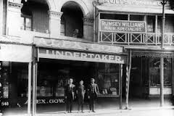
Alex Gow Funerals
For over 100 years the name Alex Gow has been synonymous with quality of service, honesty and integrity.
Established in 1840 by Andrew Petrie as Petrie’s Undertaking Establishment.
1909 Alexander Gow became the owner of the first & oldest funeral business in Queensland.
The Gow family is still actively involved with the company and are proud to be continuing the tradition of being 100% Australian & family owned.
Pre-planning (Tania Woo)

Slide 3
Today’s Outline
Statistics
Diagnosis
Causes
Break
Focus on how we think ABC Theory of Emotion Fight or Flight response Learned helplessness

Slide 4
Statistics!
Urrrggg!!
Urrrggg!!
Urrrggg!!

Slide 5
One in 5 Australians experience a mental health condition in a given year, and almost one in 2 will experience a mental health condition at some point in their lifetime.

Slide 6
In any given year around 3 million Australians are living with depression and/or anxiety.
(1 million depression, 2 million anxiety)

Slide 7
Anxiety is the most common mental health condition in Australia. (1 in 4 people – 1 in 3 women and 1 in 5 men)
Every year in Australia, approximately 14% of the population (1 in 7) experiences an anxiety disorder.
Up to 40% of the population will experience a panic attack at some time in their life.

Slide 8
Over 500,000 Australians will experience depression and a substance use disorder at the same time, at some point in their lives.
Comorbid depression and anxiety disorders occur in up to 25% of general practice patients.

Slide 9
About 85% of patients with depression have significant anxiety, and 90% of patients with anxiety disorder have depression.
Despite the availability of treatments, 40% of patients with depression or anxiety do not seek treatment, and of those who do, less than half are offered beneficial treatment.
Australian Bureau of Statistics. (2008). National Survey of Mental Health and Wellbeing: Summary of Results, 2007 (4326.0). Canberra: Australian Bureau of Statistics.

Slide 11
What do all of these boring stats tell us?
1. Depression & anxiety are highly prevalent
2. Wherever you find depression, you are likely to find anxiety!

Slide 12
Diagnosis!
The Diagnostic and Statistical Manual of Mental Disorders (DSM), is published by the American Psychiatric Association (APA), and offers a common language and standard criteria for the classification of mental disorders.

Slide 13
Depression (DSM-5 Diagnostic Criteria)
The DSM-5 outlines the following criterion to make a diagnosis of depression. The individual must be experiencing five or more symptoms during the same 2-week period and at least one of the symptoms should be either (1) depressed mood or (2) loss of interest or pleasure.
1. Depressed mood most of the day, nearly every day. 2. Markedly diminished interest or pleasure in all, or almost all, activities most of the day, nearly every day. 3. Significant weight loss when not dieting or weight gain, or decrease or increase in appetite nearly every day. 4. A slowing down of thought and a reduction of physical movement (observable by others, not merely subjective feelings of restlessness or being slowed down). 5. Fatigue or loss of energy nearly every day. 6. Feelings of worthlessness or excessive or inappropriate guilt nearly every day. 7. Diminished ability to think or concentrate, or indecisiveness, nearly every day. 8. Recurrent thoughts of death, recurrent suicidal ideation without a specific plan, or a suicide attempt or a specific plan for committing suicide.
To receive a diagnosis of depression, these symptoms must cause the individual clinically significant distress or impairment in social, occupational, or other important areas of functioning. The symptoms must also not be a result of substance abuse or another medical condition.

Slide 14
Generalised Anxiety Disorder
A. Excessive anxiety and worry (apprehensive expectation), occurring more days than not for at least 6 months, about a number of events or activities (such as work or school performance).
B. The individual finds it difficult to control the worry.
C. The anxiety and worry are associated with three (or more) of the following six symptoms (with at least some symptoms having been present for more days than not for the past 6 months): Note: Only one item required in children.
1. Restlessness, feeling keyed up or on edge. 2. Being easily fatigued. 3. Difficulty concentrating or mind going blank. 4. Irritability. 5. Muscle tension. 6. Sleep disturbance (difficulty falling or staying asleep, or restless, unsatisfying sleep).
D. The anxiety, worry, or physical symptoms cause clinically significant distress or impairment in social, occupational, or other important areas of functioning.
E. The disturbance is not attributable to the physiological effects of a substance (e.g., a drug of abuse, a medication) or another medical condition (e.g., hyperthyroidism).
F. The disturbance is not better explained by another medical disorder (e.g., anxiety or worry about having panic attacks in panic disorder, negative evaluation in social anxiety disorder [social phobia], contamination or other obsessions in obsessive-compulsive disorder, separation from attachment figures in separation anxiety disorder, reminders of traumatic events in posttraumatic stress disorder, gaining weight in anorexia nervosa, physical complaints in somatic symptom disorder, perceived appearance flaws in body dysmorphic disorder, having a serious illness in illness anxiety disorder, or the content of delusional beliefs in schizophrenia or delusional disorder).

Slide 15
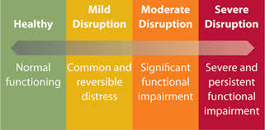

Slide 16
More puppies!

Slide 17
Causes??

Slide 18
Finding the cause(s) of depression & anxiety is very difficult to identify for 2 reasons:
These conditions are predominately caused by a combination of multiple factors interacting with one another.
Identifying which multiple factors are involved, and how they interact, differs from person to person.
These factors can be grouped into 2 broad categories:
Biological factors
Psychological factors

Slide 19
Biological factors
Genetic vulnerability
Hormones
Brain Chemicals (neurotransmitters)
Aging
Medications
Medical problems

Slide 20
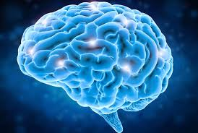
Psychological factors
Problematic thinking
Grief & Loss
Stressful life events
Family history (modelling)
Substance use

Slide 21
Genetic vulnerability
Research has identified genes that make individuals more vulnerable to low moods. Genes make proteins that are involved in biological processes. Throughout life, different genes turn on and off, so that — in the best case — they make the right proteins at the right time. But if the genes get it wrong, they can alter your biology in a way that results in your mood becoming unstable.
It is well known that depression and bipolar disorder run in families. Researchers studying twins have confirmed that depression can be inherited. The findings suggest:
that about 30% of the predisposition for developing clinical depression is due to genetics
the remaining 70% is thought to be due to other contributing factors.
Identifying genes that predispose a person to certain types of depression is a growing area of research.

Slide 22
Hormones
It has been widely documented that women suffer from major depression about twice as often as men. Because of the incidence of depressive disorders peaks during women's reproductive years, it is believed that hormonal risk factors may be to blame.
Women are especially prone to depressive disorders during times when their hormones are in flux, such as around the time of their menstrual period, childbirth, and perimenopause. In addition, a woman's depression risk declines after she goes through menopause.

Slide 23
Brain Chemicals (neurotransmitters)
Scientists have identified many different neurotransmitters. Here is a description of a few believed to play a role in depression:
Acetylcholine enhances memory and is involved in learning and recall.
Serotonin helps regulate sleep, appetite, and mood and inhibits pain. Research supports the idea that some depressed people have reduced serotonin transmission. Low levels of a serotonin by-product have been linked to a higher risk for suicide.
Norepinephrine constricts blood vessels, raising blood pressure. It may trigger anxiety and be involved in some types of depression. It also seems to help determine motivation and reward.
Dopamine is essential to movement. It also influences motivation and plays a role in how a person perceives reality. Problems in dopamine transmission have been associated with psychosis, a severe form of distorted thinking characterized by hallucinations or delusions. It's also involved in the brain's reward system, so it is thought to play a role in substance abuse.
Glutamate is a small molecule believed to act as an excitatory neurotransmitter and to play a role in bipolar disorder and schizophrenia. Lithium carbonate, a well-known mood stabilizer used to treat bipolar disorder, helps prevent damage to neurons in the brains of rats exposed to high levels of glutamate. Other animal research suggests that lithium might stabilize glutamate reuptake, a mechanism that may explain how the drug smooths out the highs of mania and the lows of depression in the long term.
Gamma-aminobutyric acid (GABA) is an amino acid that researchers believe acts as an inhibitory neurotransmitter. It is thought to help quell anxiety.

Slide 24
Ways in which neurotransmitters may contribute to depression
Not enough of the neurotransmitter (for example, serotonin) is produced
Not enough receptor sites to receive the neurotransmitter
The neurotransmitter is being taken back up too quickly (into the presynaptic) before it can reach receptor sites
Chemical precursors (molecules from which neurotransmitters are built) may be in short supply
Molecules that facilitate the production of neurotransmitters, such as specific enzymes, may be in short supply

Slide 25
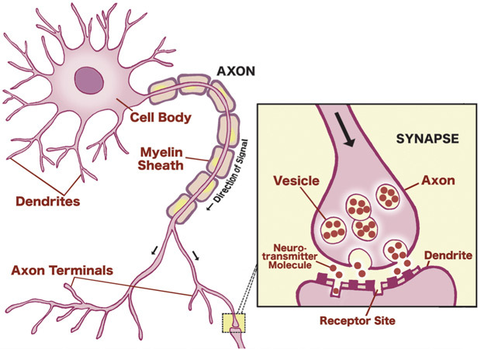

Slide 26
Influence of drug companies! Drug companies spend billions each year to promote their products.
In Australia 33 drug companies spent $8.6 million dollars sponsoring events for healthcare professionals between November 2016 and April 2017 (The Sydney Morning Herald, January 14, 2018).
The drug company AstraZeneca spent $241,000 as the sole sponsor of the Lung Foundation's Australasian Lung Cancer Trials Group (ALTG) Lung Cancer Symposium in 2016, covering accommodation and meals at Hilton Hotel in Sydney, as well as airfares, transfers and other event costs.

Slide 27
Aging
Sometimes changes to how our brain functions merely reflect an ageing process, particularly in people who are vulnerable to this kind of 'wear and tear'.
As we age, our brain function reduces and certain important neurotransmitter pathways that influence our mood can be affected. These age-related changes may be in relation to:
dementia (some elderly people experience severe depression for the first time after developing dementia).
high blood pressure or mini-strokes (often unnoticed by the individual and their family).

Slide 28
Physical health problems
Chronic physical illness can also contribute to depression and anxiety conditions or impact on the treatment of either both, or the physical illness itself. Common chronic conditions associated with depression and anxiety conditions include:
diabetes
asthma
hypertension and heart disease
Some physical conditions can mimic anxiety conditions, like an overactive thyroid. It can be useful to see a doctor and be assessed to determine whether there may be a medical cause for your feelings of anxiety.

Slide 29
Ongoing stressful events
Anxiety conditions may develop because of one or more stressful life events. Common triggers include:
work stress or job change
change in living arrangements
pregnancy and giving birth
family and relationship problems
major emotional shock following a stressful or traumatic event
verbal, sexual, physical or emotional abuse or trauma
death or loss of a loved one.

Slide 30
Personality factors
Research suggests that people with certain personality traits are more likely to have anxiety. For example, children who are perfectionists, easily flustered, timid, inhibited, lack self-esteem or want to control everything, sometimes develop anxiety during childhood, adolescence or as adults.

Slide 31
Substance use
Some people who experience anxiety and depression use alcohol or other drugs to help them manage their condition. In some cases, this may lead to people developing a substance use problem along with their mental health condition. Alcohol and substance use can aggravate these conditions particularly as the effects of the substance wear off. It's important to check for and get assistance for any substance use conditions at the same time.

Slide 32
Causes
Genetic vulnerability
Brain Chemicals
Grief & Loss
Problematic thinking
Aging
Family history (modelling)
Medical problems

Slide 33
Causes
Person 1

Slide 34
Causes
Person 2

Slide 35
Causes
Person 3

Slide 36
Causes
Person 1
Person 2
Person 3

Slide 37
Which profile?
Profile A
Profile B
Profile C
Person 2
Profile D

Slide 39
How we interpret the world around us, and explain it, is of crucial importance.
We tend to be under the illusion that how we interpret the world is ‘objective truth’, rather than ‘subjective interpretation’!

Slide 41
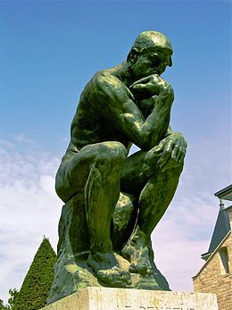
Problematic thinking
ABC Theory of Emotion
Fight or Flight response
Learned helplessness

Slide 42
ABC Theory of Emotion
According to psychologist Albert Ellis (Rational-Emotive Therapy (RET)) our feelings are governed by our thinking.
The relationship between thinking and feeling can be explained by the formula A + B = C; where A = an activating event B = the beliefs or thoughts (self talk) we have about the event, and C = the emotional consequence, or our feelings.
The theory is that by learning to identify and correct the distortions in your thinking so as to make your thinking more realistic, balanced and kinder to yourself and others, you can develop mastery of your emotions and alleviate your suffering.

Slide 45
For me, there are short-falls with this model. However, it’s a valuable tool in terms of helping us visualise the fact that we never experience an emotion without first experiencing a thought.
How we interpret the world around us becomes so well practiced over time, that our thoughts become habitual and automatic to the point where we become unaware that we’ve even had a thought.
We never ‘feel’ before we ‘think’!
So when we hear people say…
“It just happened out of the blue!’ “One minute I was fine and then boom, ‘out of the blue’ I was in a full-on panic attack!”
… it’s time to think again.

Slide 46
For me, the elephant in the room with thinking based theories such as the ABC Theory of Emotion is (ironically) their lack of emphasis on the role that emotion learning plays in determining our behaviour!
How we learn to interpret the world is tightly interwoven with powerful emotional memories.
We are not ‘logically driven’ creatures. If we were, these thinking therapies would work every single time.
We are ‘emotionally driven’ creatures!

Slide 47
B
Beliefs
Self-talk
Emotional Elephant
A
C
Event
Feelings
Core Beliefs
D
Behaviour

Slide 48
The flight or fight response
The problem with anxiety is not anxiety!
…once again, the problem is with our thinking.

Slide 49
We are all here today in part thanks to an evolutionary mechanism called the Fight or Flight Response (acute stress response).
This is a highly efficient mechanism that almost immediately prepares the body to fight or flee from danger. The fact that we have inherited such an incredibly sensitive ‘early warning’ device from our far-distant ancestors is a significant reason why we are here.

Slide 50
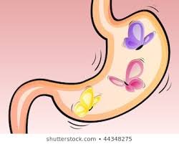
The fight or flight response is a massive, incredibly rapid and disruptive bodily upheaval that results in a lot of physical symptoms including: * increased heart rate * increased breathing rate * tensing of muscles * hands and feet cooler than usual * feel warm in the face * dry mouth * feel sick * butterflies * sweating * confusion

Slide 51
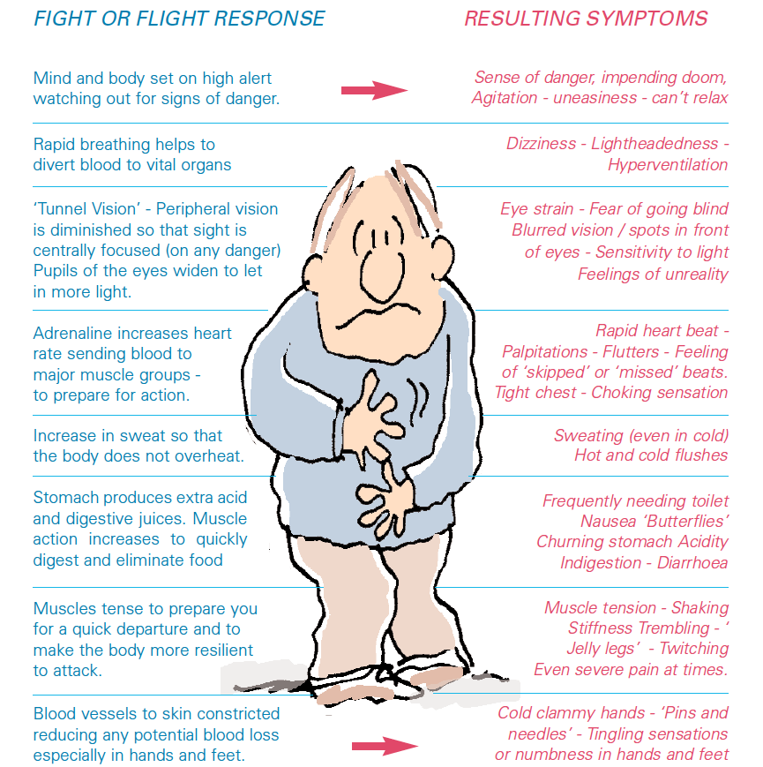

Slide 52
The reason I am presenting this phenomenon is because anxiety is commonly misunderstood. The wrong things are commonly blamed for anxiety, and these misconceptions often become so heavily reinforced over time that change becomes very difficult.
If anxiety is a problem for you, your problem is not the fight or flight response. It’s doing specifically what it is supposed to do! The problem is your thinking. We tend to make two broad thinking mistakes: 1. We make thinking errors about our environment. For example, after experiencing panic in a shopping centre queue deciding to avoid all shopping centres as a result. 2. We make thinking errors about the physiological symptoms of the fight or flight response. For example, concluding that remaining in the shopping centre would have resulted in having a heart attack.

Slide 53
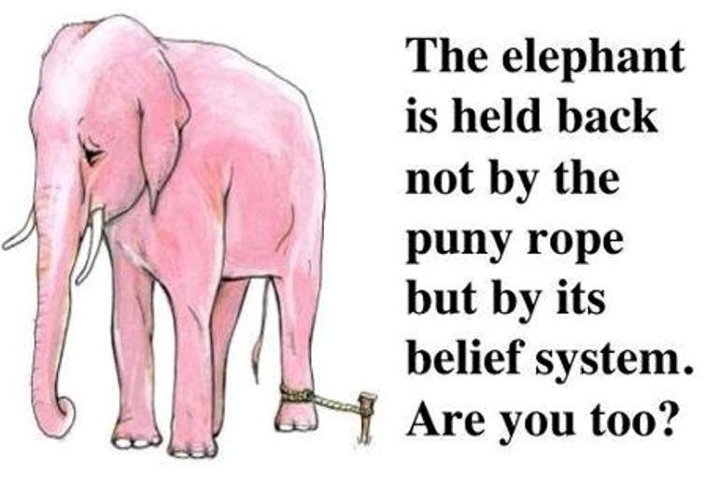
Learned helplessness
Learned helplessness was discovered about 50 years ago via some classic laboratory experiments.
It is a phenomenon observed in both humans and other animals when they have been conditioned to expect pain, suffering, or discomfort without a way to escape it (Cherry, 2017).
Eventually, after enough conditioning, the animal will stop trying to avoid the pain at all—even if there is an opportunity to truly escape it!
This phenomenon is called learned helplessness because it is not an innate trait; no one is born believing that they have absolutely no control over what happens to them and that it is fruitless to even try to gain control.

Slide 54
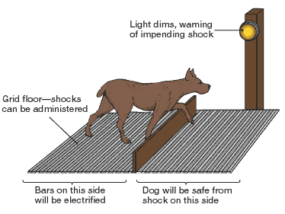
The initial experiments that formed the basis for this theory were conducted in the late 1960s and early 1970s by psychologists Martin Seligman and Steven Maier.
Seligman and Maier were working with dogs at the time and testing their responses to electrical shocks. Some dogs received electrical shocks that they could not predict or control, while others did not.
Once these results had been confirmed with dogs, Seligman and Maier conducted similar experiments on rats. This phenomenon can also be seen in elephants.
Although the human response to such situations may be more complex and dependent on several different factors, they are very much in line with the research on dogs, rats, and other animals.

Slide 55
Explanatory Styles
Based on his research, Seligman made an important connection: the link between learned helplessness and depression. An important part of this research is your ‘explanatory style’.
Martin Seligman describes an explanatory style as “the manner in which you habitually explain to yourself why events happen”.
In other words, they are the little stories we tell ourselves to make sense of our life.
Your explanatory style is your usual (fixed) pattern for interpreting and explaining bad events to yourself. Importantly, the explanatory styles of pessimists versus optimists are easily distinguished in three predictable ways (also known as the “3Ps”).

Slide 56
Personalisation: relates to the perception of causality. Events are internally or externally caused. A pessimistic tennis player will interpret the cause of a loss as personal (‘I lost because I’m just a terrible tennis player’). In contrast an optimist is likely to identify non-personal factors (‘I failed because grass just isn’t my surface’).
Permanence: relates to the perception of time. Events are perceived as permanent or temporary. Pessimists interpret setbacks as permanent (‘I’ll never be a good tennis player’). In contrast, an optimist sees the setback as only temporary (‘I didn’t prepare well for this match/I had a cold’).
Pervasiveness: relates to the perception of space. Events are perceived as global or specific. Pessimists see setbacks as all-pervasive (‘I’m terrible at everything I try’). In contrast, the optimist sees the setback as narrowly contained or confined to one area of life (‘I’m just not the right shape for tennis’).

Slide 57
Optimists assumes that good things are permanent, pervasive and internal, where bad things are seen as temporary, specific and externally caused. Pessimism is the reverse of this logic.

Slide 58
In Summary
Depression and anxiety is highly prevalent within our communities.
The cause of depression and anxiety is very difficult to identify. In most cases numerous factors combine at different levels to cause these experiences.
Seeking help or encouraging people to seek help is very important.
The brain is the most complex thing we are aware of. It can be our greatest asset, or our worst enemy! We can all benefit from taking a look at our own thinking.

Slide 59
National help lines and websites
Black Dog Institute
Information on symptoms, treatment and prevention of depression and bipolar disorder.
Carers Australia 1800 242 636
Short-term counselling and emotional and psychological support services for carers and their families in each state and territory.
Headspace 1800 650 890
Free online and telephone service that supports young people aged between 12 and 25 and their families going through a tough time.
Kids Helpline 1800 55 1800
A free, private and confidential, telephone and online counselling service specifically for young people aged between 5 and 25.
MensLine Australia 1300 78 99 78
A telephone and online support, information and referral service, helping men to deal with relationship problems in a practical and effective way.
Head to Health
An innovative website that can help you find free and low-cost, trusted online and phone mental health resources.
MindSpot Clinic 1800 61 44 34
An online and telephone clinic providing free assessment and treatment services for Australian adults with anxiety or depression.

Slide 60
National Aboriginal Community Controlled Health Organisation (NACCHO)
Aboriginal Community Controlled Health Services and Aboriginal Medical Services in each state and territory.
QLife 1800 184 527 3pm-12am
QLife is Australia’s first nationally-oriented counselling and referral service for LGBTI people. The project provides nation-wide, early intervention, peer supported telephone and web based services to diverse people of all ages experiencing poor mental health, psychological distress, social isolation, discrimination, experiences of being misgendered and/or other social determinants that impact on their health and wellbeing.
Relationships Australia 1300 364 277
A provider of relationship support services for individuals, families and communities.
SANE Australia 1800 18 7263
Information about mental illness, treatments, where to go for support and help carers.

Slide 61
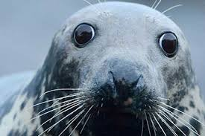
Thank you
Are there any Comments or Questions?

